Slide 1
18PYB103J
SEMICONDUCTOR PHYSICS
MODULE 4
LECTURE 4 – SOLVING PROBLEMS

Slide 2
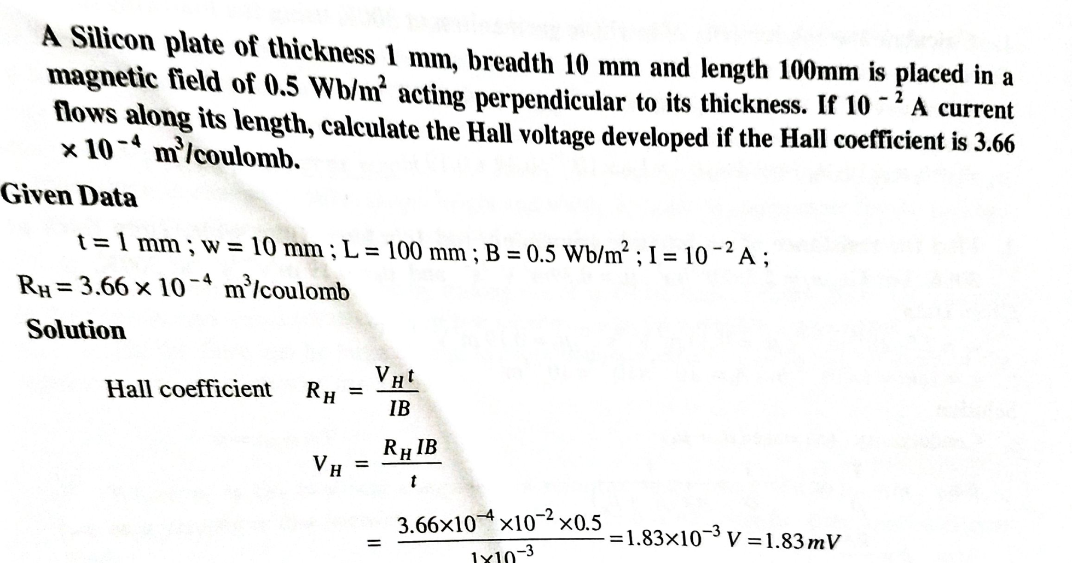
SOLVING PROBLEMS

Slide 3
SOLVING PROBLEMS
The hall coefficient of Sample A at room temperature is 4x10-4 m3 coulomb-1 . Find out the carrier concentration in sample A at room temperature .
Given:
Hall Coefficient (RH) = 1/pe
Carrier Concentration (p) = 1/ 4x10⁻⁴ x 1.6 x 10 ⁻¹⁹
= 0.15625 x 10 ²³
= 1.5625 x 10 ²² m-³

Slide 4
SOLVING PROBLEMS
Calculate the resistivity of the given material whose resistance is 3Ω; area of cross-section and length are 30cm² and 20cm respectively?
Given:
R = 3Ω
l = 20cm = 0.20m
A = 30cm² = 0.0030m²
Resistivity = RA/l = 3x0.0030/0.20
= 0.0045 Ωm

Slide 5
SOLVING PROBLEMS
Find the resistivity of a rectangular Germanium crystal of area S= 150 cm² connected through Four probe if a current of 4 mA passed through it generates a voltage of 200 mV at 35 ⁰C.
ρ =(V/I) X 2πS
= (200/4)X 2X3.14X 0.015
= 4.71 Ω⋅m

Slide 6
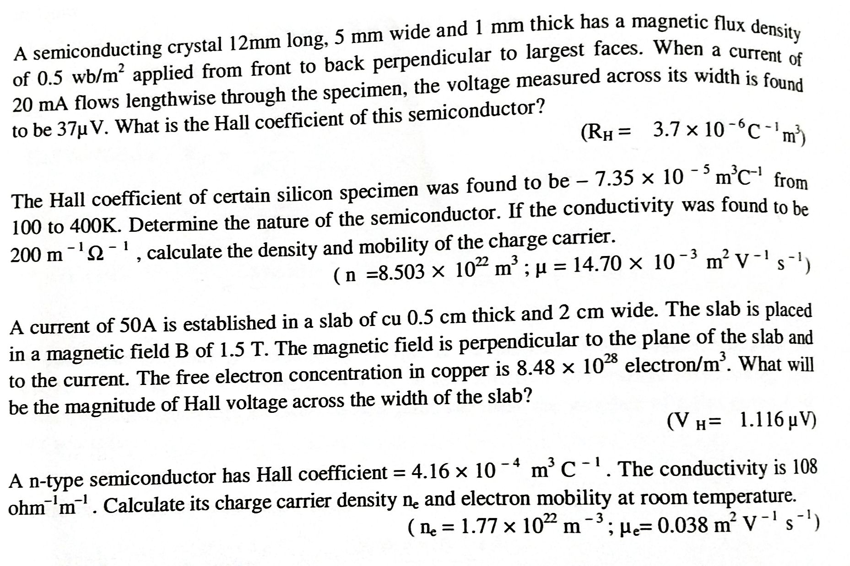
EXERCISE PROBLEMS

Slide 7


